Slide 1
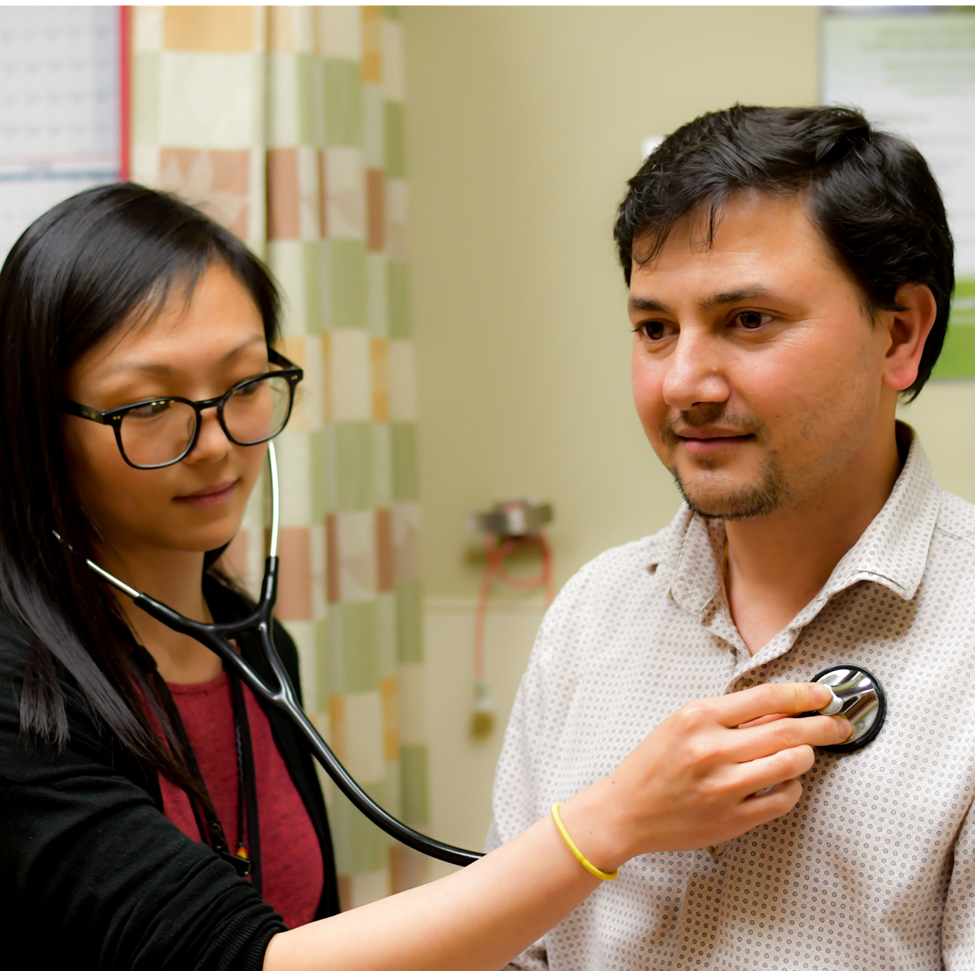
Innovating the Resident Recruitment Process to Increase Workforce Diversity
Amelia Challender, MA, Associate Program Director of Education
Cleveland Piggott, MD, MPH, Director of Diversity & Heath Equity
Michael Benavidez, MD, Director of Recruitment
Shontelle Jaramillo, Program Coordinator
Chloe Finke, DH Program Coordinator
Linda Montgomery, MD, MA, Program Director
Notes:
Shontelle

Slide 2
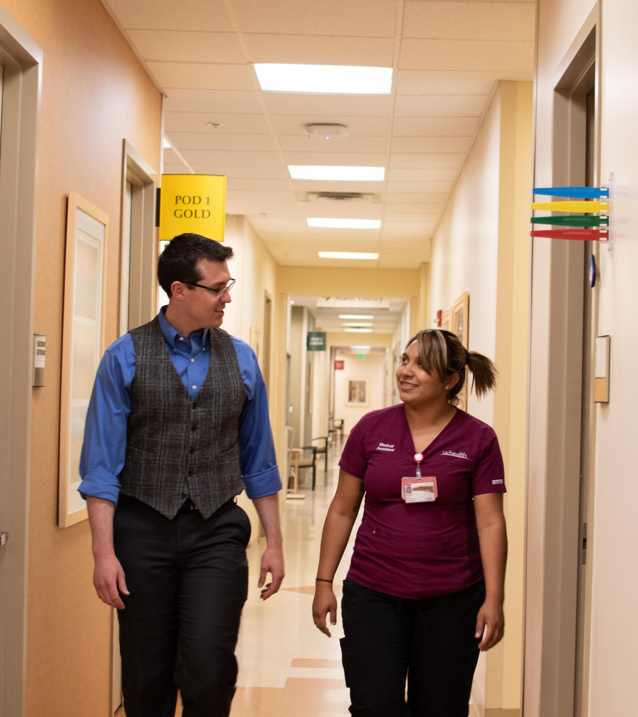
Learning Objectives
Attendees will be able to…
Identify simple innovations their residency could implement to recruit more diverse residents.
Consider methods for defining and measuring diversity within a residency.
Consider how their own program’s ERAs data can be used to provide objective measures of residency diversity over time.
Notes:
Shontelle

Slide 3
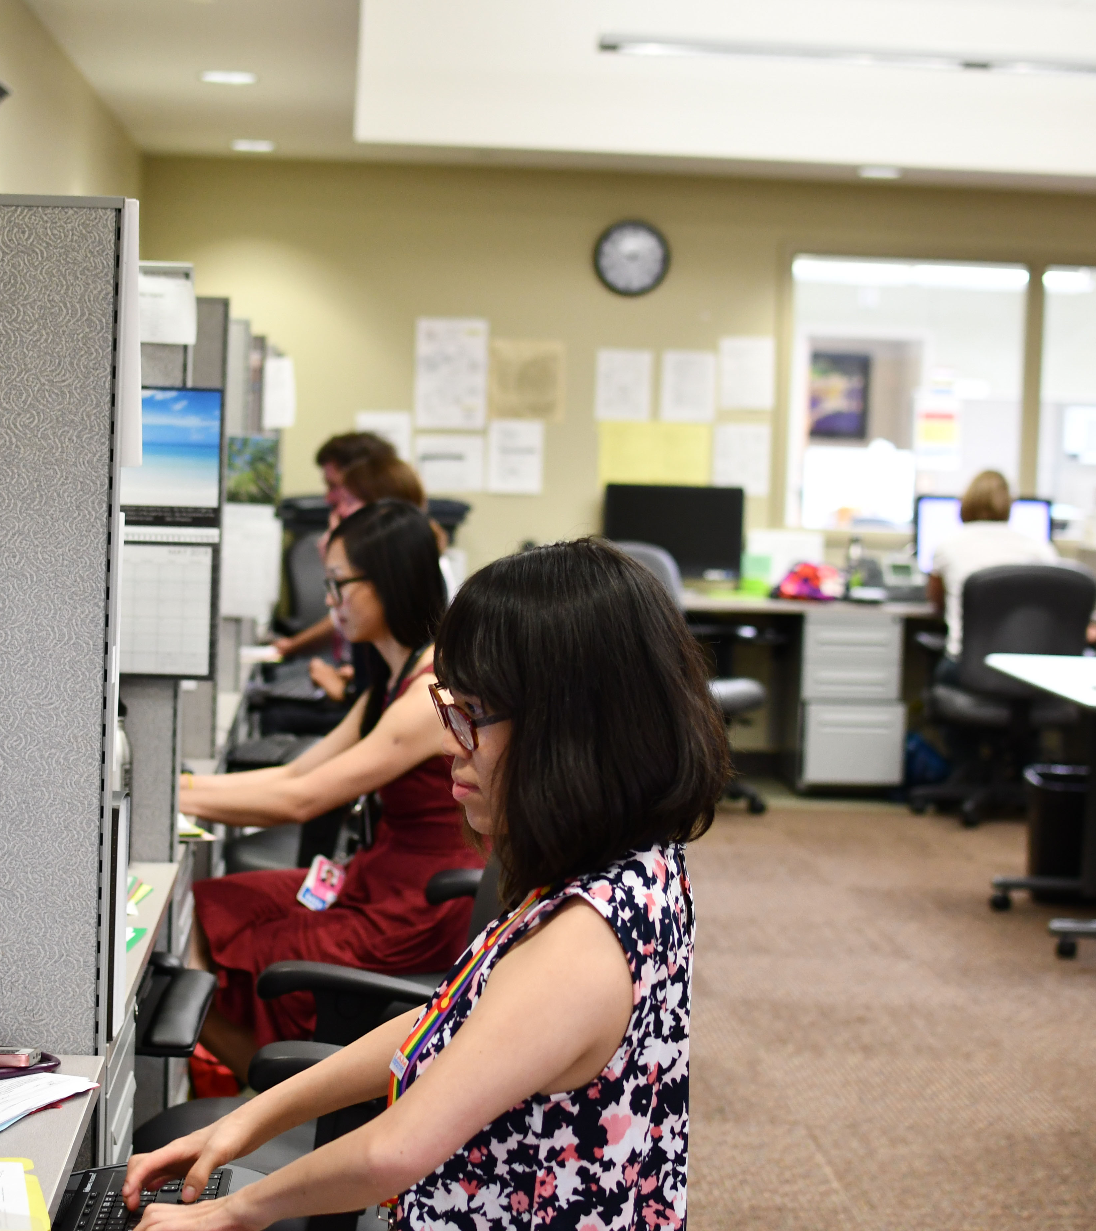
Background: Why?
Studies show that a more diverse workforce enhances team function and the quality of patient care
ACGME requirements
AAMC’s Holistic Review Model
Notes:
Cleveland

Slide 4
Background
Residencies must engage in practices that focus on mission-driven, ongoing, systematic recruitment and retention of a diverse and inclusive workforce of residents, fellows, faculty members, senior administrative staff members, and other relevant members of its academic community.
Notes:
Cleveland

Slide 5
Background
Holistic review is a flexible, individualized way of assessing an applicant’s capabilities by which balanced consideration is given to experiences, attributes, and academic metrics (E-A-M) and, when considered in combination, how the individual might contribute value as a medical [trainee] and future physician.
Notes:
Cleveland

Slide 6
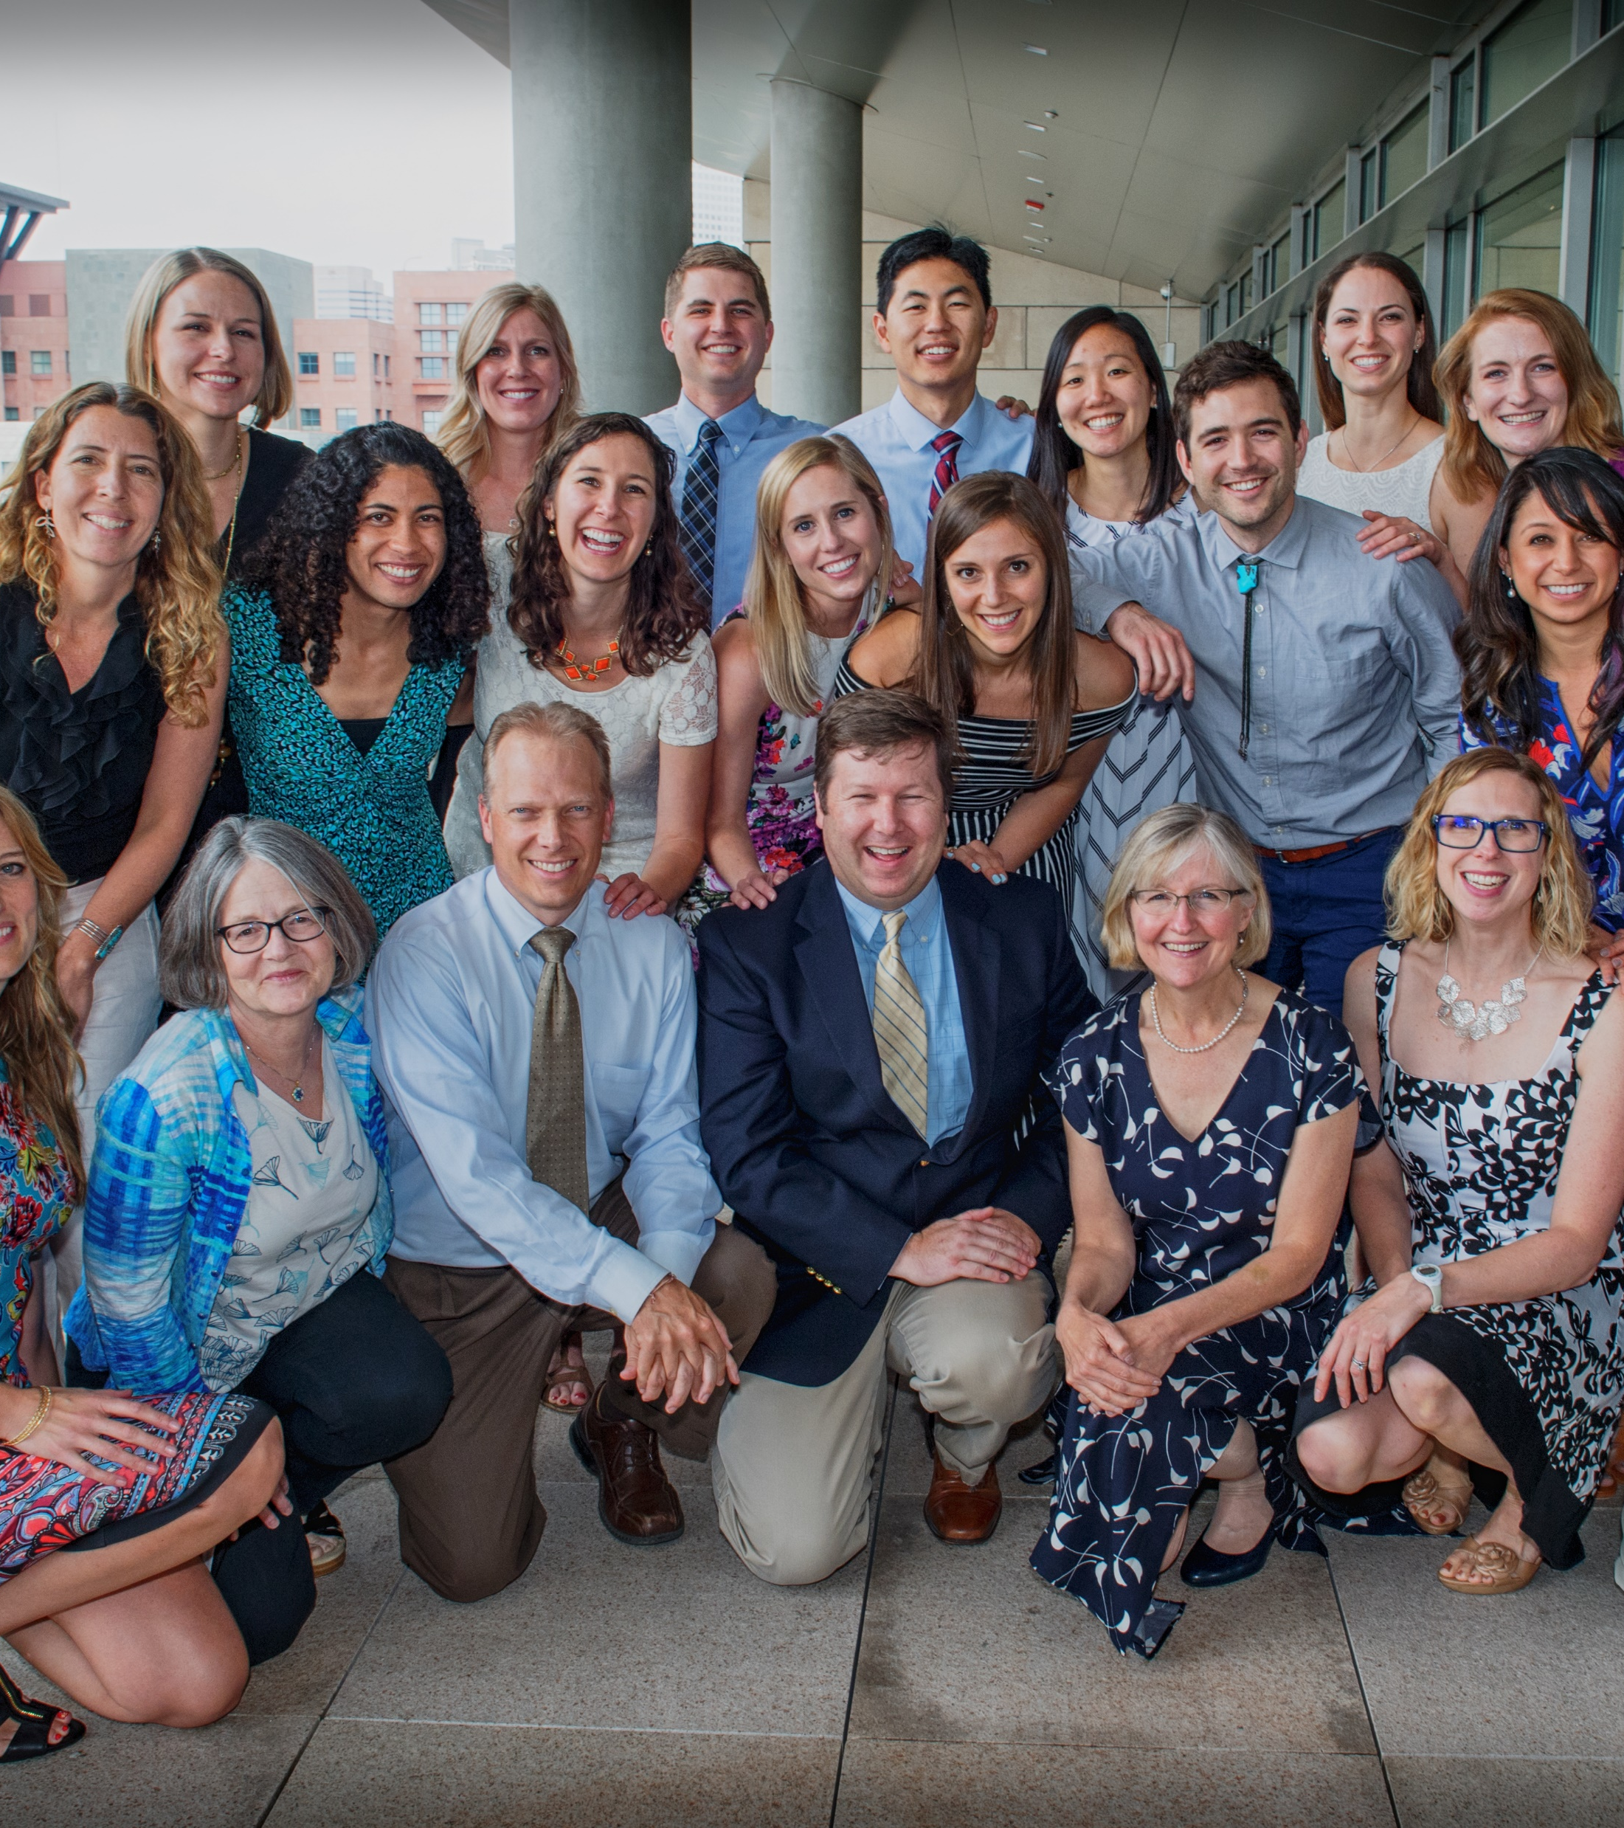
Goal = Match a more diverse residency class
Our definition of diversity:
First, residents of races traditionally underrepresented in medicine (URM: Blacks, Mexican-Americans, Native Americans [American Indians, Alaska Natives, and Native Hawaiians], and mainland Puerto Ricans.)
Secondarily People of Color (POC), meaning non-white.
Notes:
Cleveland

Slide 7
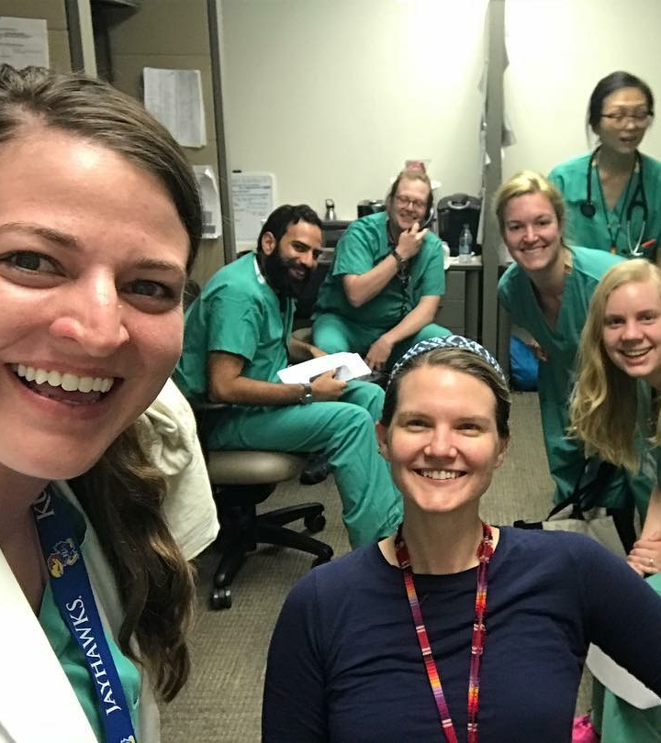
Innovations (2018-19 season)
Changes to initial application review
Guest lecture and workshop
Interviewer training
Interview evaluation rubric
Improved marketing materials
Second Look for Minority Scholars event
Notes:
Amelia

Slide 8
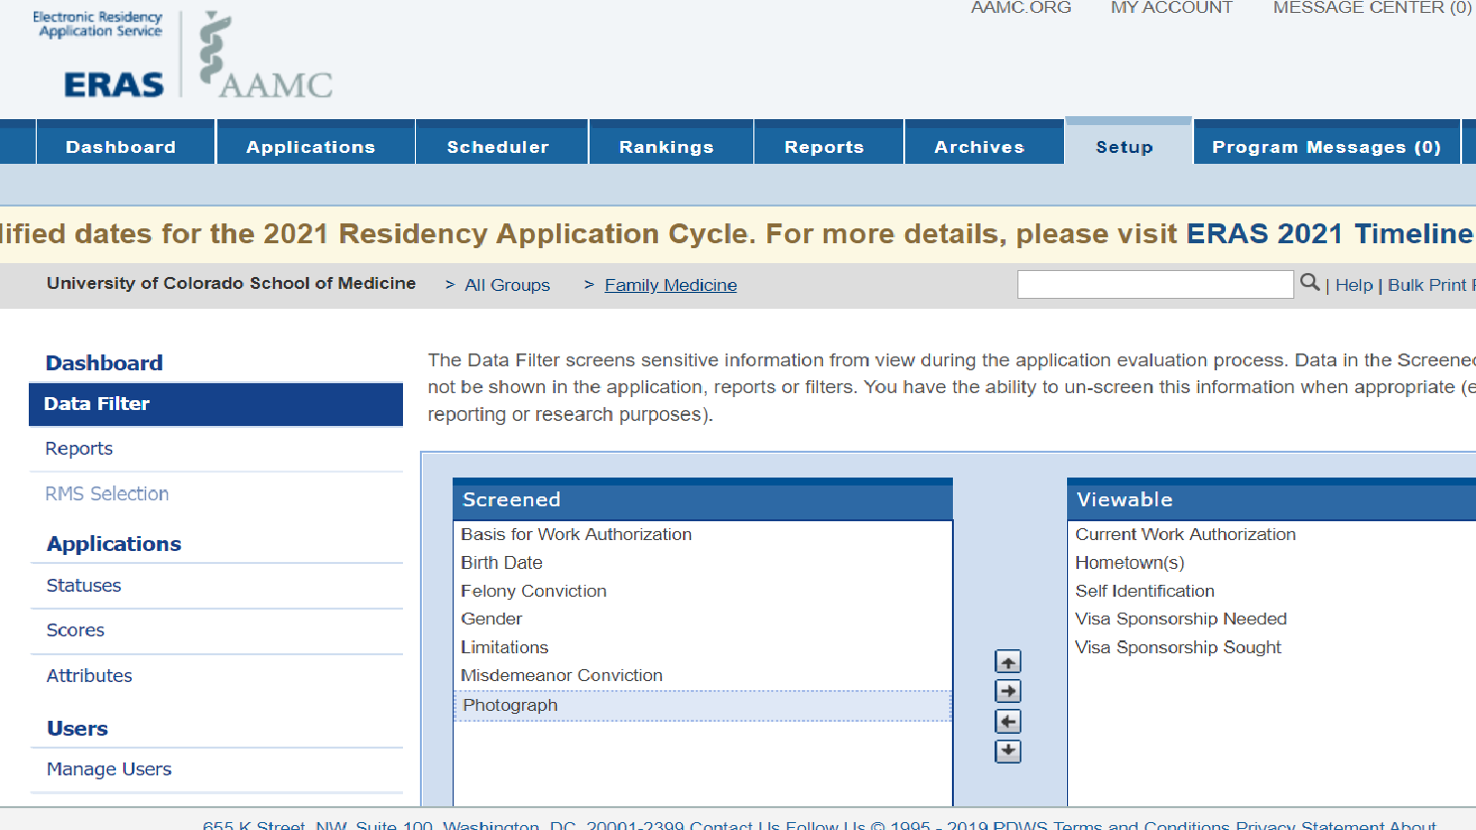
Changes to initial application review
Blinding reviewers to applicant photos,
Using a formal rubric, and
Training reviewers
Notes:
Amelia

Slide 9
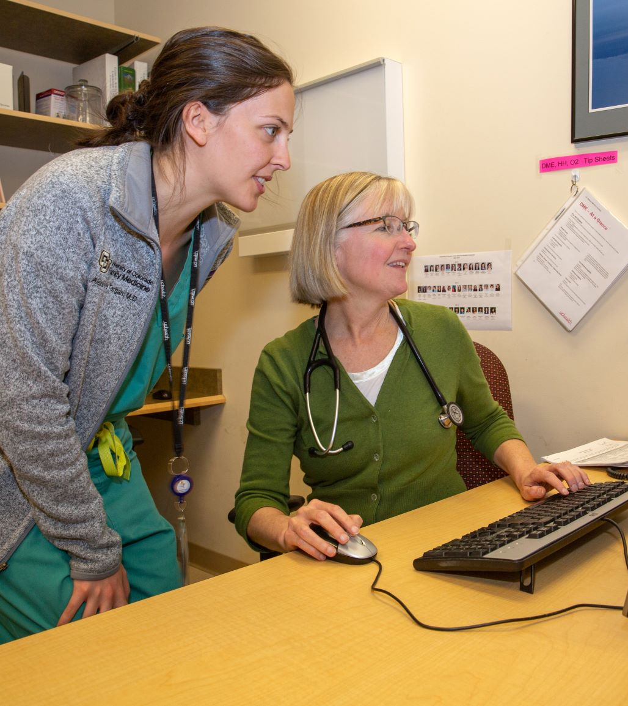
Training
Training for application reviewers on common biases
Guest lecture and workshop led by Jessica Guh, MD, Swedish Family Medicine Residency at Cherry Hill
Training for all interviewers about holistic review, biases common in interviewing, and using our new interview rubric
Notes:
Amelia

Slide 10
Interview Evaluation Rubric
Aligned with the AAMC’s holistic review model
Notes:
Amelia

Slide 11
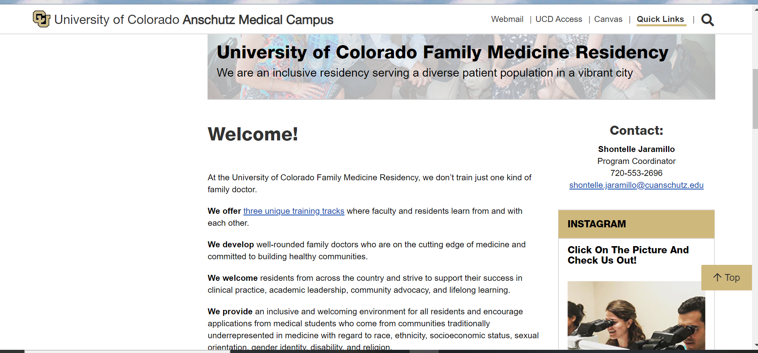
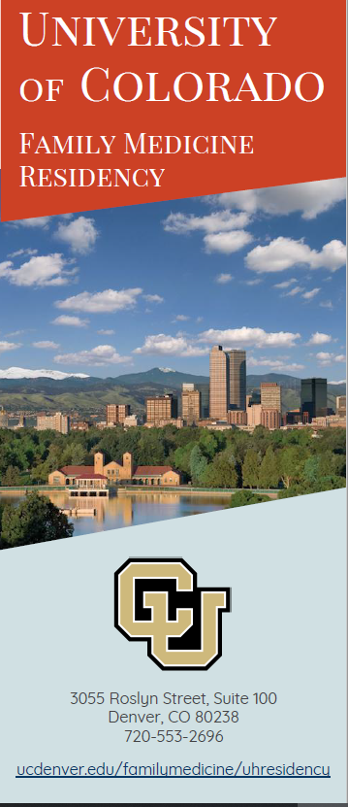
Improved marketing materials highlighting our diversity
Notes:
Chloe
Website, brochure, slide show.

Slide 12
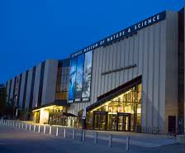
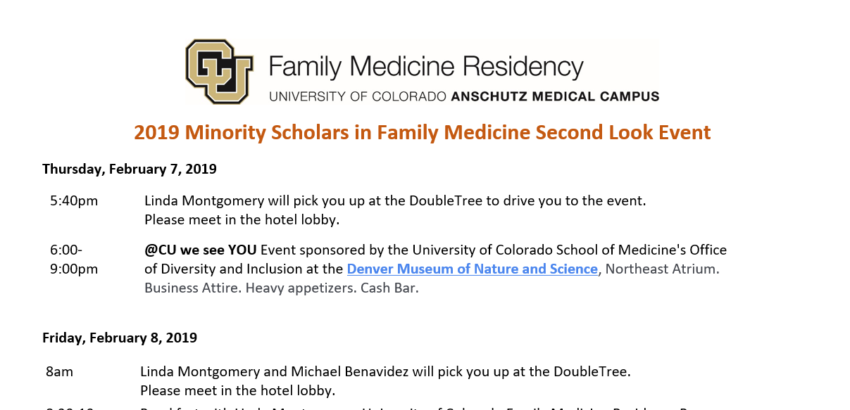
Second Look for Minority Scholars
Partnered with CU SOM
Invited top URM applicants
Time for socializing and tours
2019: Matched 2 of 5 attendees
2020: Matched 0 or 5 ☹

Slide 13
Evaluation Methods
Our formative and summative evaluation included:
A survey of all interviewees,
A survey of attendees of our second look event, and
An analysis of ERAS data by comparing descriptive statistics from these recruitment seasons:
Pre-Intervention: 2016-17 and 2017-18
Post-Intervention: 2018-2019 and 2019-20 (preliminary)

Slide 14
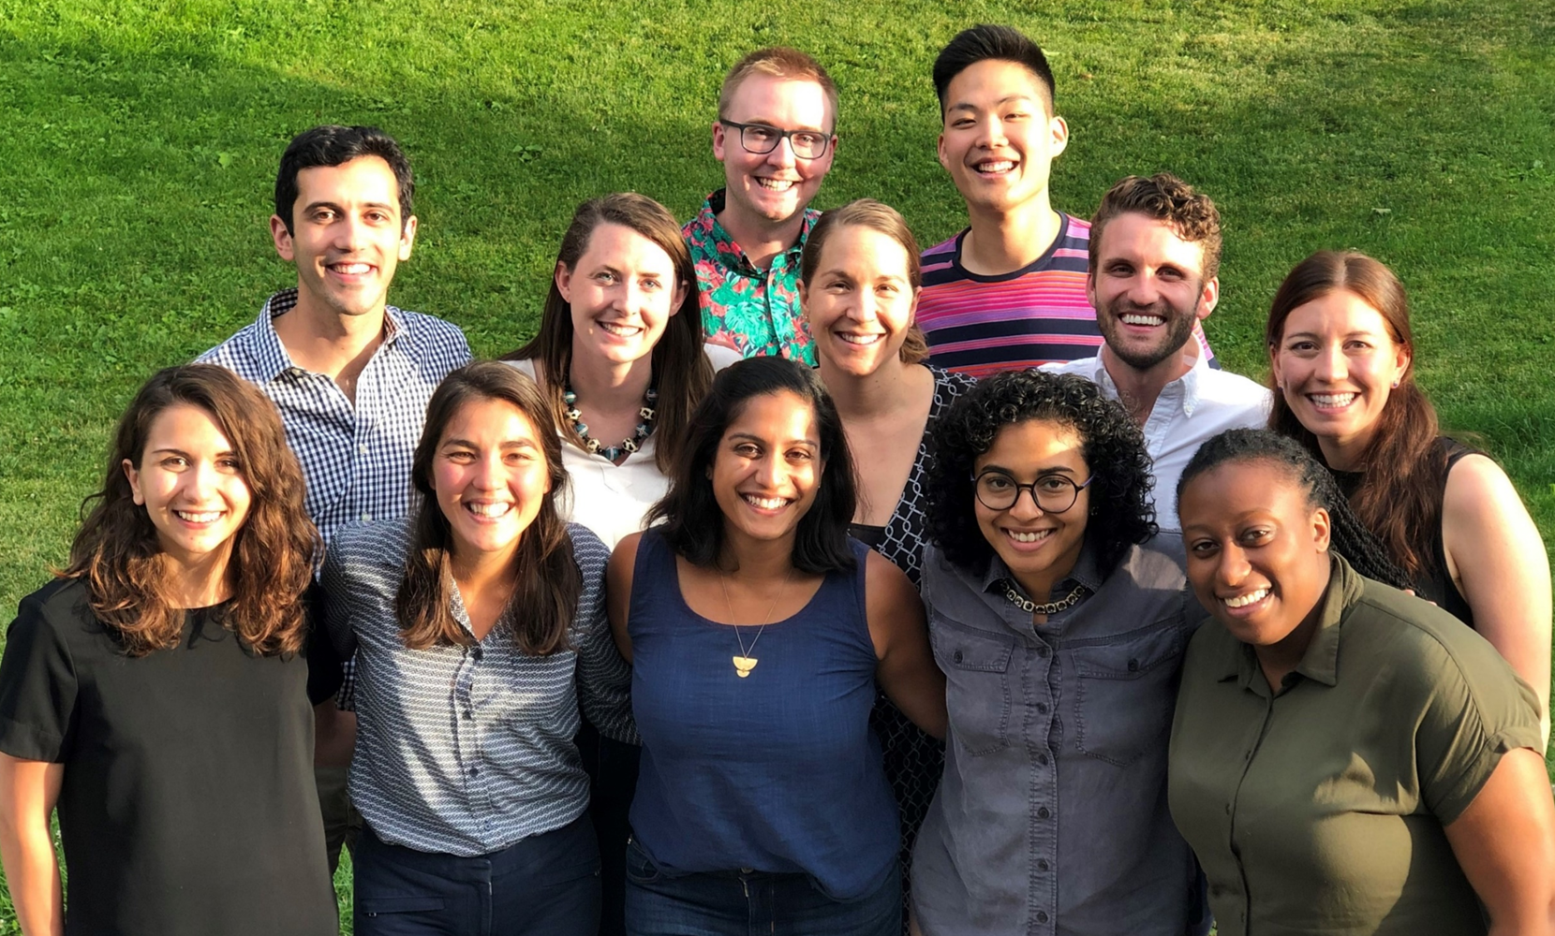
Outcomes

Slide 15
Notes:
The racial distribution of all applicants varies over time. There is a statistically significant linear trend (increasing) in URM applicants over time from 2017 to 2020. Cochrane Armitage test for trend (URM vs all other): z=2.2012, p=.0285

Slide 16
Notes:
Interviewees: There is a statistically significant linear trend (increasing) in URM interviewees over time. Cochran-Armitage test for trend: z=2.05, p=.0442

Slide 17
Notes:
Matches: Because the numbers of applicants matched each year is small, we are unable to determine if any changes are statistically significant.

Slide 18
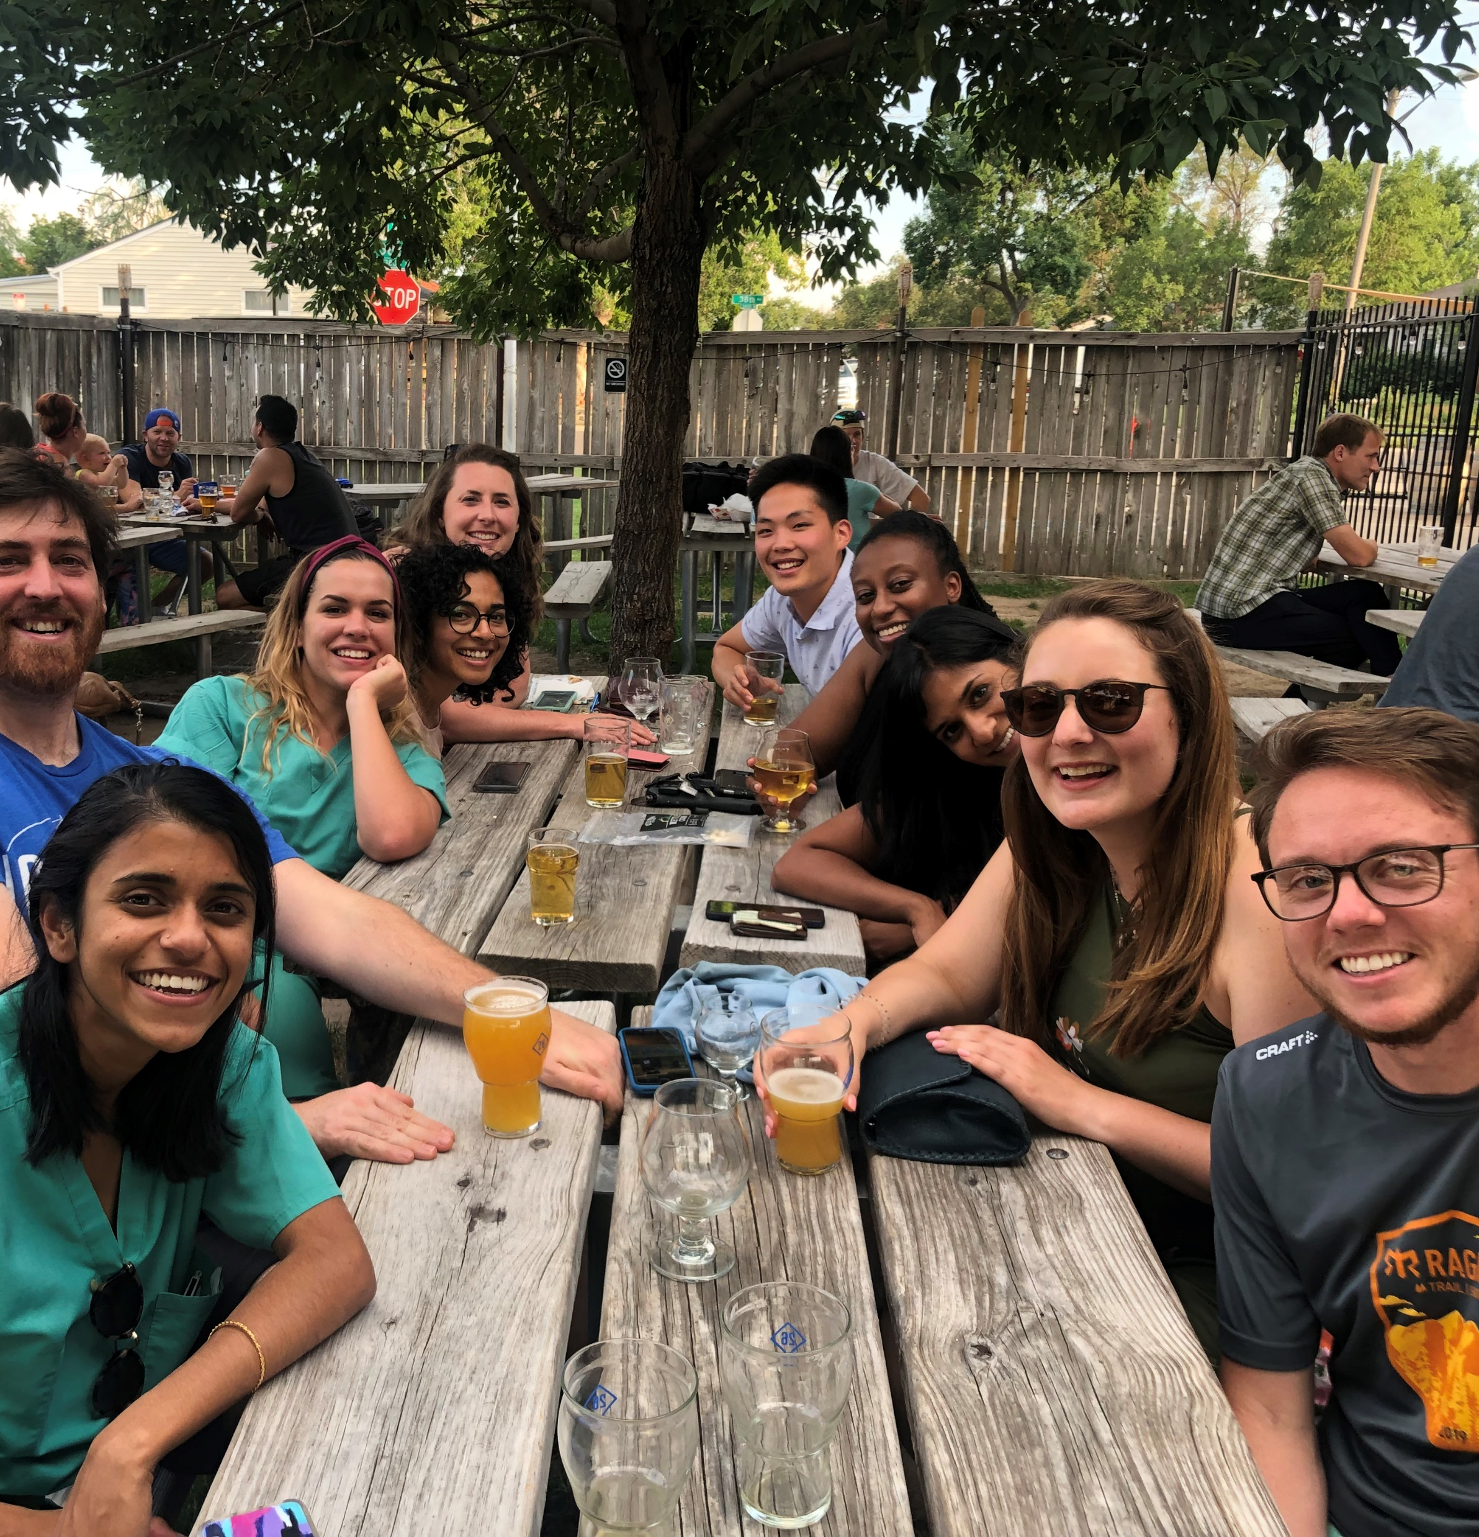
Next Steps
Highlight our diversity even more by developing a video for our website and a document for interviewees that describes our diversity: Diversity Video
Incorporate holistic review into our processes for faculty recruitment and acting intern selection
And… (surprise!)
Revamp our recruitment process to be completely virtual!
Notes:
Diversity Video: 2:42
https://www.youtube.com/watch?v=_9NB_ctRZoE

Slide 19
AAMC Holistic Review Resources
The COVID-19 pandemic has caused dramatic and disruptive changes to all aspects of medical education. AAMC's Holistic Review team has curated resources and tools to help program directors navigate resident selection during this challenging time.
Tools and Resource links: Overview of the Holistic Review Framework - This 8-minute video will introduce you to the conceptual underpinnings of holistic review as applied to graduate medical education. Activity 1: Applicant Criteria Identification and Prioritization - This activity will help you to "widen the lens" through which you assess residents by identifying and ranking the mission-driven Experiences, Attributes, Competencies, and Metrics (EACMs) that would add value to your program (Word document). Application of Holistic Principles in Resident Selection - This 4-minute video will help you to think through the elements of the resident selection process you can control and those you can influence and how Holistic Review can be applied to resident selection. Activity 2: Applying Holistic Review to Resident Selection - This activity will help you define your high-priority criteria and assess if your recruitment materials and selection processes reflect your priorities (Word document). Overview and Application of the Holistic Review Framework to GME Selection - This resource is a compilation of all the above if you would prefer to read the content rather than watch the videos (PDF).

Slide 20
References
Bourke, J. (2016). Which Two Heads are Better Than One?: How Diverse Teams Create Breakthrough Ideas and Make Smarter Decisions. Australian Institute of Company Directors.
Chin, M. H., Clarke, A. R., Nocon, R. S., Casey, A. A., Goddu, A. P., Keesecker, N. M., & Cook, S. C. (2012). A roadmap and best practices for organizations to reduce racial and ethnic disparities in health care. Journal of general internal medicine, 27(8), 992-1000.
Page, S. E. (2019). The diversity bonus: How great teams pay off in the knowledge economy (Vol. 5). Princeton University Press.
ACGME, ACGME Common Program Requirements (Residency), Effective July 1 2019, Retrieved October 9, 2019 (https://www.acgme.org/Portals/0/PFAssets/ProgramRequirements/CPRResidency2019.pdf).

Slide 21
Discussion: Please answer in the chat!
What modifications is your program considering for this year’s recruitment season?
How might these modifications impact applicants from diverse backgrounds?

