Slide 1
Like a rock: Ethical Challenges in the Medical Management of a Unique Patient with Multiple Myeloma
Amanda mullen, MD PGY2; Jacob Anderson, DO PGY2
Southern Colorado Family Medicine Residency program

Slide 2
Disclosures
None

Slide 3
Learning Objectives
By the end of this presentation, participants will be able to…
Apply the four principles of medical ethics (patient autonomy, beneficence, non-maleficence, and justice) to a unique case.
Discuss the difference between capacity and competence.
Discuss Colorado-specific medical law with determination of Medical Durable Powers of Attorney (MDPOA).
Consider health disparities of the Transgender community in caring for patients.

Slide 4
Case
HPI: A 62-year-old transgender female with history of aortic dissection and schizophrenia was found down after a 1-week history of dizziness and weakness.
Vitals: Hypertensive
PE: unremarkable
Labs: Cr 8.9, BUN 81, K = 4.4
Imaging: unremarkable

Slide 5
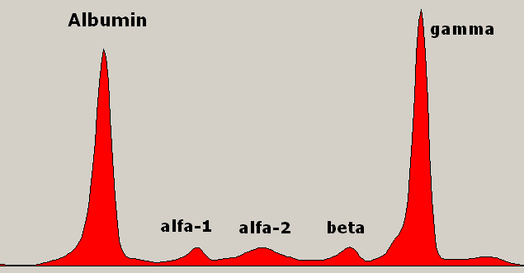
Further workup
Consults: Nephrology
Further labs: high amyloid, low kappa/lambda ration
Procedures: Renal biopsy – glomerulosclerosis consistent with multiple myeloma
Final Diagnosis: Multiple myeloma

Slide 6
The Prolonged Stay
Patient desired dialysis and occasional blood transfusions
Refused oncologic treatments
Capacity in question with most refusals
No next of kin or POA
Team approach: psychiatry, case management, hospital ethics committee
151 days later, the patient agreed to hospice services, and expired one day before official transition of care

Slide 7
Set up for Failure
Fluctuating capacity
No assigned POA – difficulty assigning one
Lack of resources in the community
Barriers to care

Slide 8
Four Pillars of Medical Ethics
Autonomy
Beneficence
Non – maleficence
Justice

Slide 9
Capacity and Competence
Capacity: the ability to make health care related decisions
Competence: the legal term determining if a patient is qualified to make such decisions

Slide 10
Colorado Next of Kin Law
The state appoints a medical POA instead of assigning next of kin

Slide 11
Health Disparities in the Transgender Community
“The priorities for research on barriers to transgender health care must include determination of the gaps in knowledge among the provider workforce across the range of training, potential interventions for those gaps, determination of indirect barriers like environment and stigma, and potential solutions to overcome those barriers.” Safer et al., 2017

Slide 12
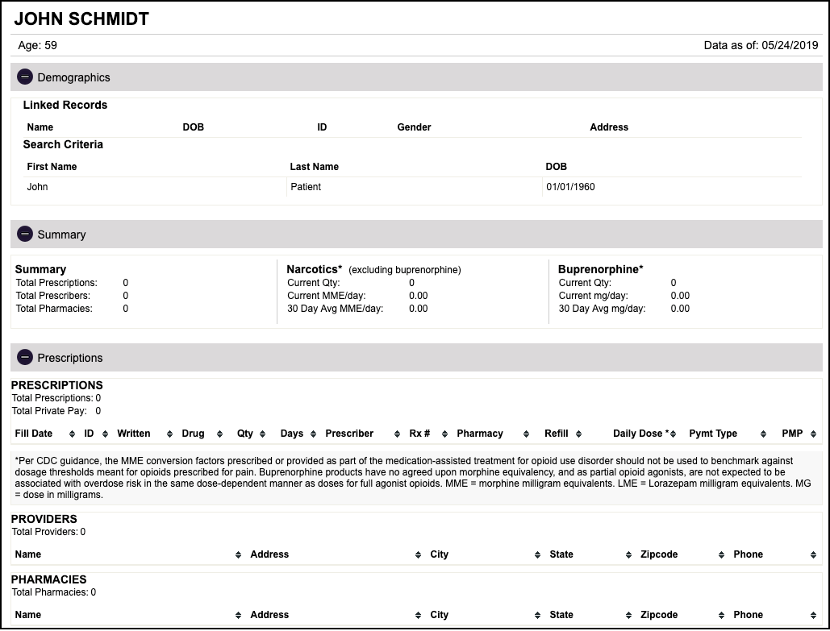
Future Directions
Database for goals of care/POA
Mail out to all Colorado residents

Slide 13
Questions and Answers

Slide 14
Contact Information
Amanda Mullen
Email: amandamullen@centura.org

Slide 15
References
Turner DT, MacBeth A, Larkin A, Moritz S, Livingstone K, Campbell A, and Hutton P. The Effect of Reducing the "Jumping to Conclusions" Bias on Treatment Decision-Making Capacity in Psychosis: A Randomized Controlled Trial With Mediation Analysis. Schizophr Bull. Sep 2018. Available from: doi: 10.1093/schbul/sby136.
Spencer BWJ, Gergel T, Hotopf M, and Owen GS. Unwell in hospital but not incapable: cross-sectional study on the dissociation of decision-making capacity for treatment and research in in-patients with schizophrenia and related psychoses. Br J Psychiatry. Aug 2018; 213(2):484-489. Available from: doi: 10.1192/bjp.2018.85.
Sugano K, Okuyama T, Lida S, Komatsu H, Ishida T, Kusumoto S, Uchida M, Nakaguchi T, Kubota Y, Ito Y, Takahashi K, and Akechi T. Medical Decision-Making Incapacity among Newly Diagnosed Older Patients with Hematological Malignancy Receiving First Line Chemotherapy: A Cross-Sectional Study of Patients and Physicians. PLoS One. Aug 2015; 10(8)):e0136163. Available from: doi: 10.1371/journal.pone.0136163.
Safer JD, Coleman E, Feldman J, Garofalo R, Hembree W, Radix A, and Sevelius J. Barriers to Health Care for Transgender Individuals. Curr Opin Endocrinol Diabetes Obes. Apr 2016; 23(2): 168-171. Available from: doi: 10.1097/MED.0000000000000227.
White BP and Fontenot HB. Transgender and non-conforming persons' mental healthcare experiences: An integrative review. Arch Psychiatr Nurs. Apr 2019;33(2):203-210. Available from: doi: 10.1016/j.apnu.2019.01.005.
Bradford J, Reisner SL, Honnold JA, Xavier J.
Gillon R. Medical Ethics: Four Prinicples Put Attention to Scope. BMJ. Jul 1994; 309:184.
Durable Power of Attorney For Health Care. Pursuant to Colorado Revised Statues. Section 15-14-501, et seq. Available from: http://www.imagj.com/PDFs/Durbable%20power.pdf.
Colorado Patient Autonomy Act. 15-14-503, et seq. Experiences of transgender-related discrimination and implications for health: results from the Virginia Transgender Health Initiative Study. Am J Public Health. Oct 2013; 103(10):1820-9. Available from: doi: 10.2105/AJPH.2012.300796.
Lesbian, Gay, Bisexual, and Transgender Health. US Department of Health and Human Services. 2012. Available from: http://www.healthypeople. gov/2020/topicsobjectives2020/overview.aspx?topicid=25.

