Slide 1
Case-Based Learning: Innovation and Collaboration to Address Rural Hospital and Primary Care Practice Needs During a Pandemic
Lauren S. Hughes, MD, MPH, MSc, FAAFP / Farley Health Policy Center
Benjamin D. Anderson, MBA, MHCDS / Colorado Hospital Association

Slide 2
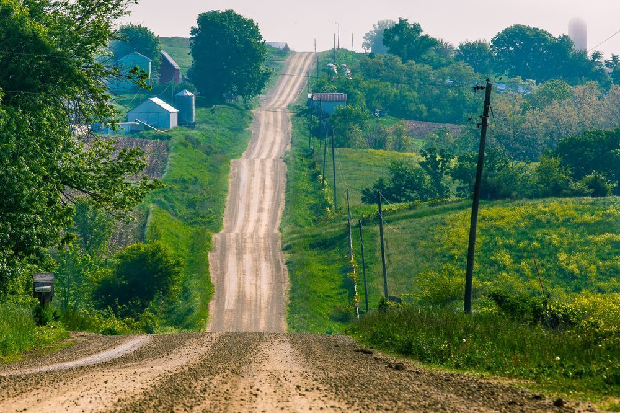
A playbook for when there’s no playbook
Sarahville Health Center
Mountain Plains Family Health Clinic

Slide 3
Common COVID-19 challenges
Nine mini-chapters
Structured content within each
Clinical care
Communication
Community
Cross-system collaboration
Space
Spending
Staffing
Statistics and surveillance
Supplies
Continuation of the case study
Strategic thinking prompts
Practical guidance
Pearls from your peers
Additional resources

Slide 4
Methodology to create the playbook
Rapid review of the literature
Peer-reviewed (PubMed, Google Scholar, MedRxiv)
Gray literature (Google)
Key informant interviews
32 one-hour interviews, including 9 hospital administrators, 5 governance members, 6 primary care clinicians, 5 rural public health professionals, and 7 patients and community members
Analysis of available resources
Rural specificity; produced by a reputable organization; frequently updated; dynamic information; easily navigable; highly applicable + practical advice

Slide 5
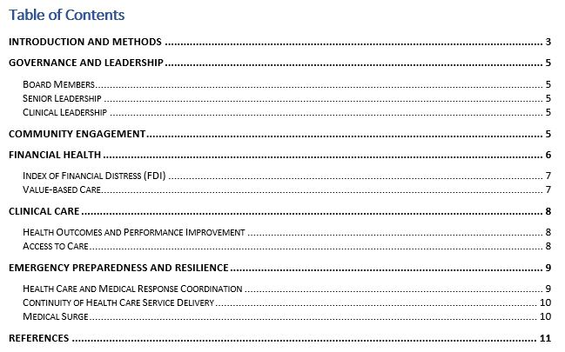
Rural health care delivery system assessment tool

Slide 6
Educational applications
Introduce complex adaptive systems, how to navigate and lead them
Teach problem solving skills during an unprecedented crisis
Learn how to design innovative interventions
Assist organizations in completing the assessment tool

Slide 7
Questions?
Lauren Hughes: lauren.hughes@cuanschutz.edu
Benjamin Anderson: Benjamin.Anderson@cha.com

