Slide 1
Establishing an Acute Care Clinic as a Means to Improve Patient Access
Timothy Hutton, MD, Ryan Peterson, MD, MPH, Lauren Thomas, MD
Saint Joseph Hospital Family Medicine Residency

Slide 2
Learning Objectives
Understand steps taken to implement acute care Clinic
01
Gage impact on access to care within family medicine clinic
02
Assess whether clinic Adds value to residency experience
03

Slide 3
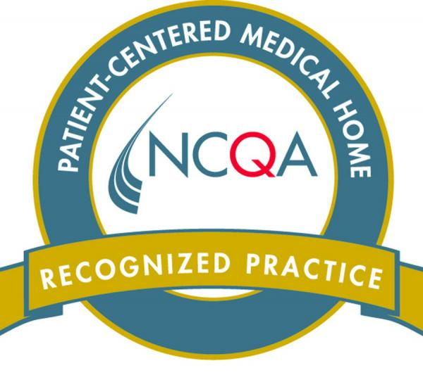
Bruner Family Medicine
Underserved, busy residency clinic
Patient centered medical home
Keep open appointments for same day access (≈30%)
Notes:
Polling data shows 42% of Americans cannot are unable to see a doctor or nurse the same or next day – 2016 Commonwealth Study
As part of PCMH certification, keep a certain number appointments available for same day
These appointments open up the afternoon prior (for the next AM), or the morning of (for the PM)

Slide 4
PROBLEM
No available EOV appointments (or long wait)
Patients calling in for same day slots for non-acute needs
Lack of continuity of care with PCP
Lack of same day slots for acute needs
High demand for Established Office Visit (EOV) slots
Continued need for same day Open Access (OA) acute slots
Notes:
Many of us have been learning about this terminology - EOV or OA slot as part of our Quarterly provider metric meeting and daily huddles Some aspects of practice management are an important measure of patient access that many primary care offices, such as BFM are graded on.

Slide 5
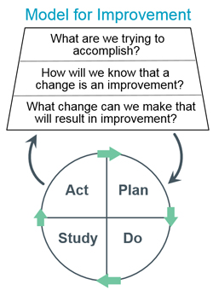
Quality Improvement Model
Monthly meetings were held to review data
Discuss changes going forward
Notes:
Our team initiated a quality improvement project using the Act, Plan, Study, Do cycle. This graphic from IHI – Institute for Healthcare Improvement
Primary Objective: Improve access to acute care within Bruner Family Medicine and increase resident exposure/training regarding acute care.
Proposed Intervention: Initiate Monday/Friday afternoon Acute Care Clinic with a total x10 twenty minute appointments per half day.

Slide 6
Proposed intervention
Monday and Friday afternoon clinic
Same day acute visits
20 additional urgent visits per week
Establish an Acute Care Clinic on those days with the highest demand for same day visits:
Added educational benefit to increase resident exposure to acute visits
Notes:
increased exposure to acute care visits may have educational value for residents pursuing work in Urgent Care or ER settings.
A twice weekly (Monday/Friday) Acute Care Clinic staffed by third year Family Medicine residents was established. This resulted in 20 new Acute Care visits per week. It was determined that Monday and Friday represented highest need for improved access given lack of weekend hours

Slide 7
Project Implementation
August 2019
Consensus on Intervention
October 2019
Intervention started
December 2019
September 2019
Work-flow designed
March 2020
Schedule built into Epic
Staff Trained
Primary diagnosis assigned each visit
Initial provider surveys reviewed
Changes to schedule made
Providers surveyed after each visit
Clinic currently discontinued secondary to COVID-19
November 2019
Reviewed primary diagnoses and acuity of appointments

Slide 8
Data Collection and Analysis
Providers were sent a three-question satisfaction survey with a 1 to 5 Likert Scale
Primary diagnoses were analyzed for each visit by team members with the assistance of Clinical Informatics team

Slide 9
Visit data for October through March
Addition of 396 acute care visits
97% scheduled same day
Majority of visits determined to meet criteria for acute care
Most common diagnosis was viral infection
Average “no show” rate is 5.3%
Notes:
Addition of 396 Acute Care Clinic appointments since implementation
97% of these scheduled same day.
Average no show rate 5.3%.
Most common visit diagnosis was viral infection.
Majority of visits determined to meet criteria for acute care appointments.

Slide 10
Provider Survey Results
100% Agree/Strongly Agree that they saw more acute visits than in typical continuity clinic
100% Agree/Strongly Agree that participating in this clinic was a valuable educational experience
30% Neutral on enjoying their experience as an acute care provider

Slide 11
Selected Quotes from Providers
“Would be impossible to do any procedure with this clinic flow”
“Very busy, and therefore any procedures may be hard to fit in”
“Clinic has very few no-shows”
“It was a good variety … a few things I probably wouldn’t see typically”

Slide 12
Strengths
Increased resident experience
Increased acute care access
Limitations
No time for procedures
Removes provider from continuity clinic
Hectic clinic with low no-show rate
Valued educational experience

Slide 13
Additional Questions to Answer?
Does this model lead to more patient continuity?
Does this model lead to more EOV visit availability?
Were patient’s satisfied by this additional clinic?

Slide 14
Changes proposed during PDSA cycle
Reduce the number of total visits from 10 to 9 in order to allow for more time for procedures
Notes:
Residents were hoping to get more exposure to I&Ds, casting splinting, et

Slide 15
Future Goals (before COVID-19)
Improved work-flow
Lengthened appointment times
Additional staffing assistance could improve provider efficiency
Scale-up
Notes:
Addition of the Acute Care Clinic was successful in promoting access for acute care needs. while providers reported gaining experience with more acute visits than those typically seen in continuity clinic.
Patients have yet to be surveyed regarding this clinic, however this may be reflected in our overall Press-Ganey patient quality surveys that are sent continuously

Slide 16
Questions and Answers
Did this acute care model require an additional attending in the clinic?
No, this could be easily fit into the existing schedule because it is staffed by third-year residents who require less supervision, most are independent in procedures and only have mandatory precepting for all OB and Medicare patients
Additional questions???

Slide 17
Thank you to all our associates who participate in our regular Quality Improvement efforts

Slide 18
Contact Information
Timothy Hutton, MD,
Timothy.hutton@sclhealth.org
Lauren Thomas, MD
Lauren.Thomas@sclhealth.org
Ryan Peterson, MD, MPH
Ryan.Peterson@sclhealth.org

