Slide 1
Sprint Optimization of the Electronic Health Record (EHR)
Dr. Eric Kim, University of Colorado Family Medicine Residency
Dr. Amber Sieja, University of Colorado School of Medicine, Senior Medical Director of Informatics
Co-Authors: Katie Markley, MD; Heather Holmstrom, MD; Stephen Rotholz, MD; Cortney Arellano, EHR Manager; CT Lin, MD
CAFMR Rocky Mountain Research Forum
May 15th, 2020

Slide 2
Disclaimers and Acknowledgements
Funding: UCHealth funds Sprint team. No other funding was provided for this study.
Primary participants: Sprint team members and clinical staff (UCHealth employees), informaticists (UCHealth consultants) and clinical faculty (School of Medicine employees).
I am presenting this data as a resident in the University of Colorado School of Medicine Family Medicine Residency Program.

Slide 3
Why Sprints?
Organizational satisfaction surveys indicate:
EHR is at the center of clinical dissatisfaction

Slide 4
Educational Objectives
Explain the difference between EHR maintenance and EHR optimization
Describe the role of a Sprint team in the user-centered optimization of the EHR
Understand some of the preliminary implications of the UCHealth Sprint team’s work on future targets for optimization

Slide 5
Typical EMR Life Cycle: Maintenance vs Optimization
Initial Acquisition and Testing of EHR
Training of Clinical Users
EHR Deployment to IT Infrastructure
Optional?
EHR Maintenance
EHR Optimization
Training of New Users
Repeat and Advanced Training of Users
Break Fixes
Development of New Functions
EHR Maintenance
Customization of Functions
Typically Few Regulatory Barriers
Typically Requires Consensus

Slide 6
Why change the way we approach the EHR?
“It’s one thing to go live and a completely different thing to see it through…After go-live, both request for fixes and changes increased exponentially.” (1)
“Analysts needed to reconcile the tension created by organizational mandates focused on standardization of the EHR process with the primary care team’s demand for EHR customization…Optimization should be performed with an in-depth understanding of the workflow, cognitive, and interactional activities in primary care.” (2)
Much of the published data on optimization is qualitative by survey, interview, or focus groups. (2,3)

Slide 7
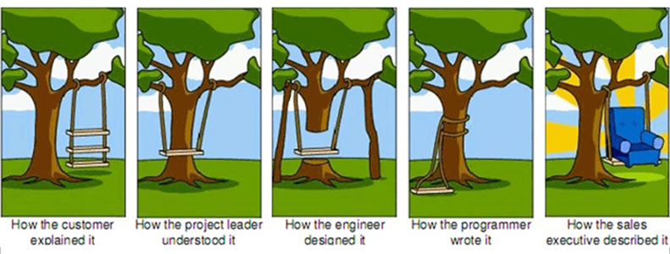
Top down, or bottom up?
https://blog.lansa.com/rapid-application-development/ambiguity-in-requirements

Slide 8
Modern Software Optimization: Agile Development And Sprints
https://www.scnsoft.com/blog/regression-testing-in-agile-development

Slide 9
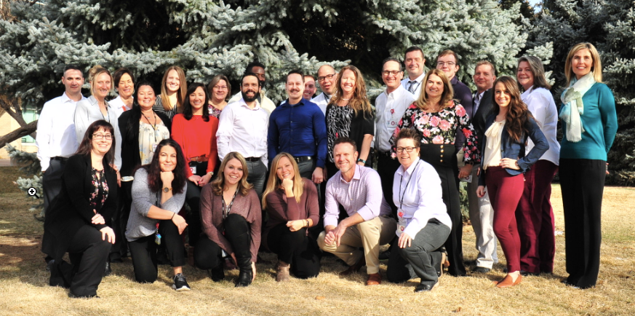
Sprint Team Structure
Good distribution between new software, software fixes, and workflow fixes
1 Physician Informaticist (PI)
1 Project Manager (PM)
1 Clinical Informaticist, RN (CI)
4 Ambulatory Trainers (+1 lead)
3 Epic Ambulatory Analysts (+1 lead)
We work with clinicians and staff to discover and improve the critical intersections between the EHR and clinical workflows to provide a more satisfying provider, staff and patient experience.
- UCHealth Sprint team mission

Slide 10
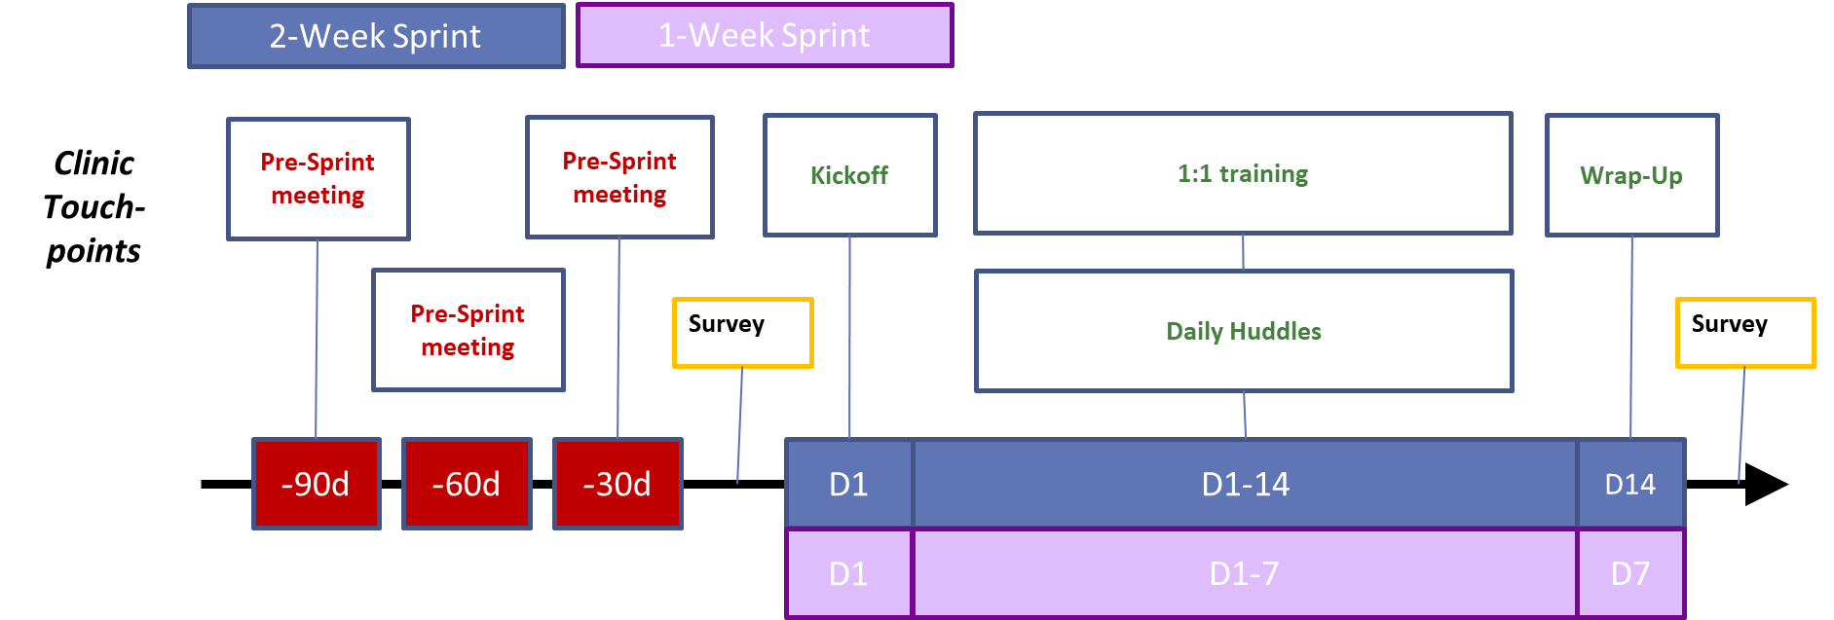
Timeline of UCHealth Sprints
Items and Final Status Logged Daily

Slide 11
Final Numbers
Total number of Sprint weeks | Total number of items addressed | Total number of clinical participants
31 | 1254 | 945
Item Logs Retrospectively Reviewed
Coded by Clinical Efficiency, IT team, and Intervention
Retrospective Data Analyzed
190513_MG_GynOncTSurg
190520_MG_FirestoneWC
190624_MG_AspenCreek
190708_AMC_Rheum
190708_MG_OBGYNRangewood
190729_AMC_PPSPAT
190729_MG_NorthNeuroPMR
190904_AMC_PainAndSpine
190909_MG_SouthUCs
190930_MG_Loveland
190930_MG_SterlingWindsor
191007_AMC_FootAndAnkle
191028_AMC_Psych
191028_MG_GreeleyFMPeds
191111_AMC_Endo
191111_MG_Greeley
191202_AMC_ID
191202_MG_SouthMetro
200106_AMC_UroGyn
200113_AMC_Allergy

Slide 12
Clinical efficiency distribution as expected

Slide 13
End user requests are dispersed into “best fit” IT application teams
53%

Slide 14
Unexpected: security team received disproportionate #requests
76%

Slide 15
Security updates can influence high impact workflows

Slide 16
Majority of requests DO NOT require net new build

Slide 17
What does Sprint do?
Provides direct line of communication between users and IT resources
Partners with users to direct training, maintenance, and feature enhancements
Gives a new perspective on optimization targets
Ex, consider reducing security barriers
Generates shared empathy between clinical and health IT teams that facilitates user-centered optimization

Slide 18
Questions?
https://clipartart.com/images/compter-clipart-4.jpg

Slide 19
References
Leventhal R. Trend: EHR optimization. Post-implementation advancements. Leaders from various healthcare organizations explain how they have been moving forward with their EHRs following implementation. Healthcare Informatics 2014;31(2):30. Available from: https://www.ncbi.nlm.nih.gov/ pubmed/24812989. PMid:24812989
Pandhi N, Yang WL, Karp Z, Young A, Beasley JW, Kraft S, Carayon P. Approaches and challenges to optimising primary care teams' electronic health record usage. Inform Prim Care. 2014;21(3):142-51. doi: 10.14236/jhi.v21i3.57. PMID: 25207618; PMCID: PMC4258388.
Moon MC, Hills R, Demiris G. Understanding optimisation processes of electronic health records (EHRs) in select leading hospitals: a qualitative study. BMJ Health & Care Informatics 2018;25:doi: 10.14236/jhi.v25i2.1011
Sieja et al. Optimization Sprints: Improving Clinician Satisfaction and Teamwork by Rapidly Reducing Electronic Health Record Burden. Mayo Clinic Proceedings. May 2019;94(5):793 – 802.

