Slide 1
Training Backward
Looking at End Goals to Advance Family Medicine Education
Megan Lykke
Randall Reitz
Joseph Kanopsic
John Draminski
Zebulon Friedly
Jeff Cochran
St Mary’s Family Medicine Residency
Richard Ott
Colorado Mesa University
Kyle Horst
Cal State Chico University

Slide 2
What is Training Backward?
-Dr. Lykke worked in towns of 800, 5,000, and 11,000. ALL changed from full spectrum FP to dividing out to hospitalists and ambulists. Has what family doctors “do” changed?
-Traditional studies of scope of family medicine have surveyed individual physicians about their scope of practice.
-The end goal of family medicine may not be what a physician desires to do, but what they are hired to do. So we surveyed employers to see what they said about the scope of practice they hired.
The question was “What are employers (corporate or private) hiring family physicians to do?”
Remember that n=1 is not 1 physician, but 1 employer

Slide 3
Methods
For this study, Colorado was divided geographically into 4 equal quadrants and one resident was assigned to each quadrant.
A standard series of questions were generated that assessed the scope of Family Medicine Physicians within the practice.
Researchers then searched online for Family Medicine/Primary Care clinics, Hospitals, and Urgent Care offices and generated a list of potential sites from each county to contact.
Each researcher then contacted prospective sites in their designated area and requested to speak with human resources, the chief medical officer or another appropriate party who could provide answers to the proposed questions.
Questions were completed by each practice and emailed back to the researcher. The researcher then reviewed the responses and manually entered them into Survey Monkey where the data was tracked.
Goal was to get at least 2 responses from each county.

Slide 4
Distribution of Colorado between Researchers
Colorado was segmented into 4 quadrants based on population.
All areas included both urban and rural areas.
Colorado has a large highly populated urban area in the middle of the state only encompassing 5 counties.
The surrounding areas are mostly rural.
If you look at data by county- then you get a heavier weight to rural areas.

Slide 5
Colorado County Size vs Practices
4 County Population Sizes
Small: Under 75K (52 responses)
Medium-Small: 75k to 200k (9 responses)
Medium-Large: 200k to 400k (11 responses)
Large: Above 400k (18 responses)

Slide 6
Family Medicine Physicians Duties
 | Ambulatory Care | Hospitalist | Urgent Care | ER Coverage | Prenatal Care w Deliveries | Prenatal Care Only
Small (52) | 48 | 22 | 17 | 15 | 17 | 6
Med-SM (9) | 9 | 2 | 0 | 1 | 4 | 1
Med-LG (11) | 11 | 5 | 1 | 0 | 7 | 2
Large (18) | 18 | 5 | 1 | 1 | 6 | 2
 | Ambulatory Pediatrics | Hospital Pediatrics | Nursing Home | Newborn Admits in Hospital Setting | ER-hospitalist (FP is ER doc & admits patient from ER) | c-sections | c-scope
Small (52) | 40 | 16 | 19 | 18 | 5 | 19 | 6
Med-SM (9) | 8 | 4 | 3 | 4 | 0 | 4 | 1
Med-LG (11) | 9 | 1 | 3 | 1 | 0 | 1 | 0
Large (18) | 12 | 9 | 7 | 5 | 1 | 2 | 2

Slide 7
152.4
ANOVA P-value = .135
T-test P-value = .064 for Small vs Large
65.3
23.8
5.4
52
9
11
18

Slide 8
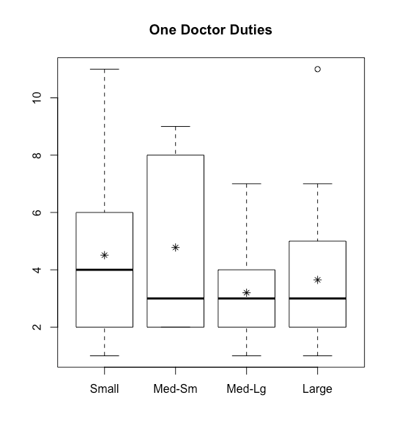
Appears Doctors in Smaller Counties Perform More Duties
ANOVA p-value = .36
T-test p-value = .03 for Small vs Large

Slide 9
(Semi) Significant Differences in Proportions of Small and Large Provider Services
Service | Small (52) | Large (18) | P-value
Urgent | 17 | 1 | .046
ER | 15 | 1 | .082
C Section | 19 | 2 | .076
Ambulatory Care | 11 | 0 | .076
No Adult Hosp Admit | 21 | 3 | .112
No ER Pediatrics | 32 | 3 | .002
ER Ped - Family MD | 12 | 9 | .072
ER Ped - ER MD | 10 | 11 | .003
No Hosp Ped | 30 | 3 | .005
Hosp Ped - Family MD | 19 | 13 | .022
Hosp Ped - Ped MD | 6 | 6 | .087
Clinic Ped - Ped MD | 3 | 5 | .039
Clinic Ped - PA/NP | 35 | 7 | .052

Slide 10
Interest in Rural Certification
Size | Yes | Percentage
Small | 34 of 52 | 65.4%
Medium-Small | 6 of 9 | 66.6%
Medium-Large | 10 of 11 | 90.9%
Large | 16 of 18 | 88.9%

Slide 11
So what do Family Physician’s DO?
Ambulatory Care of adults and pediatrics
Hospital Care of adults and pediatrics
Urgent Care
Emergency room care
OB care (prenatal care and deliveries and C-sections)
WE HAD “YES” ANSWERS TO ALL OF THESE THINGS

Slide 12
How does this inform Family Medicine Residency Education?
ACGME REQUIRMENTS
Ambulatory Care
Inpatient Care
ER
Geriatrics
Pediatrics ill and ambulatory
Newborns
GYN care
OB
Dermatologic conditions
Integrated behavioral health
Mental illness
Procedures
Health Systems
ICU?
Surgery?
Musculoskeletal? (has traditionally been orthopedics?)
Electives?
Exposure to a variety of subspecialities?
Diagnostic Imaging?
NO urgent care
Are these necessary for the “end goals” of family medicine training?

Slide 13
Questions for discussion
Do we need to focus medical school on introducing medical students to a broad range of medicine, then NARROW residency training to just the end goals of what they will actually do as physicians?
Are there areas of training that need more focus?
Are there areas of training we can get rid of?
We need to remember rural areas in our training and not just urban areas- in both design and funding. Loss of scope of family medicine would affect rural areas.
Should some programs focus on a “ruralist” certificate with broader training, and others on more urban training?
How would that look?

Slide 14
Family Medicine’s Strength
Family medicine is a gap filler specialty that can adapt to numerous environments
It is not tied to a hospital or a clinic
A graduate of family medicine has the most job options of any specialty upon graduation:
Ambulist
Hospitalist
Ruralist (broad spectrum)
Urgent Care
Emergency medicine

Slide 16
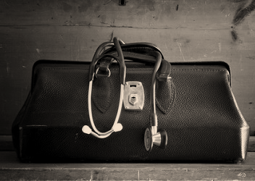
Please describe an event or factor that led you to narrow your scope of practice.
How do you feel about this change?
What supports would have been helpful in maintaining a full-spectrum / rural practice?
Discussion

Slide 17
Grounded
Theory
Hypothesis creation,
not hypothesis testing
Investigates the subjective experience of participants
Data come from analysis of interviews of people addressing a similar issue
End result is a model to explain the shared experience

Slide 18
Sample
Outreach to self-identified
rural residencies
Snowball sample

Slide 19
Data 1
Goal: Refine our Method
Three 10-20 minute phone interviews
Transcribed
Each coded by 4 researchers
Questions refined

Slide 20
Data 2
Goal: Collect our data
Thirteen additional phone interviews
Transcribed
Each coded by 2-4 researchers
Creation of themes and model

Slide 21
Data 3
Goal: Ensure saturation
Five additional phone interviews
Transcribed
Compare new data with model

Slide 22
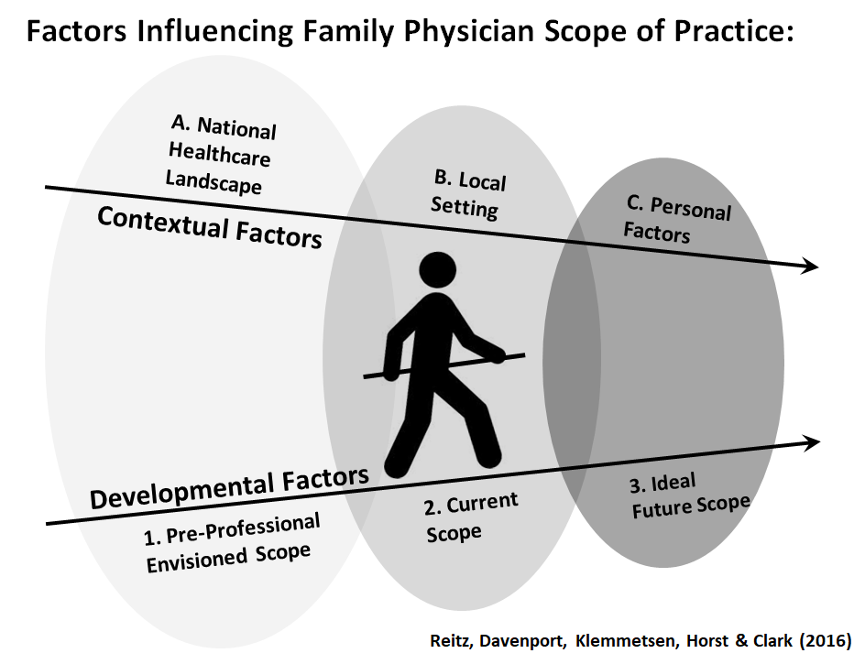

Slide 23
TABLE 1: Broad Healthcare Landscape
Theme | Interview Example
A1. Pre-Professional Envisioned Scope Medical school bias | I went to medical school in Boston and they didn’t even have a family practice department or residency. It made me understand that I wanted to do a little bit of everything.
B1. Current Scope Generational shifts toward shiftwork, balance, and medicine as income | I think there’s a change in the current generation and to some extent my generation. They enjoy medicine, but they don’t want to give up things like family, free time out of doors, and I think that is just continuing to move forward. When I was in residency it was sort of a calling. You were going to a small town; you were going to be on call every night; you were going to do everything. You know everyone in town was going to love you, but it’s going to cut into your lifestyle.
B2. Current Scope Under appreciation of generalists by patients. | I think there’s a sense that patients, even in rural areas, don’t expect physicians to do everything, and in fact, they don’t necessarily like it in some ways. In other words, before they’d say, “yeah my doctor admits me and takes care of me in the hospital.” And now, there’s a lot more, “well is the gastroenterologist gonna see me?”
B3. Current Scope Reduced reimbursement and higher costs for services outside clinic | You just don’t get reimbursed the same for doing things outside of the office. You have to really get creative, and I think in full spectrum medicine there’s a lot of overhead that comes with it, which makes it really hard to go on your own.
B4. Current Scope Knowledge and skills now too broad to maintain a full scope | If you consider where you were at 30 years ago, 50 years ago, what you need: the medicines, policies and procedures, it’s a lot to understand. Then you have to apply that to the hospital, to the nursing home, to the OB floor, etc. It’s a lot.
C1. Ideal Future Scope Scope will depend on national malpractice trends | I would stick with OB, but it’s just that malpractice insurance is so expensive.

Slide 24
TABLE 2: Local Factors
Theme | Interview Example
A1. Pre-Professional Envisioned Scope Matches with a residency with rural full-spectrum emphasis | I only interviewed at residencies with a strong reputation for giving a broad range of experience for a rural environment. You know including obstetrics and hospitals.
A2. Pre-Professional Envisioned Scope Unopposed Residency | Residents need to learn the skills to be independent. Because we did rotations with specialists that were great teachers, because those specialists don’t have their own surgical residents or some specialty residents, that I got enough comfort that if I wanted to go into the emergency room, I could.
A3. Pre-Professional Envisioned Scope Good experiences in full-spectrum medicine electives | We were an unopposed residency in Maine and we had our hospital. It was the most wonderful experience I’ve ever had. And, you know, everybody welcomed us with open hands and we got a lot of good pediatrics backgrounds and so I was happy that I did that.
B1. Current Scope First job post-residency is rural full-spectrum medicine | I think that’s really sort of the crux of the decision because I think to practice full spectrum family practice in a rural setting, if you don’t do that fairly quickly after residency you’re gonna lose a lot of those skills and a lot of that comfort that would allow you to do that.
B2. Current Scope Proximity to hospital and supportive specialists | It became apparent that if you you’re gonna practice 30 minutes from the hospital, then OB just wasn’t practical.
B3. Current Scope Broad regional differences | I also think that where we are on the East Coast, it’s a little bit harder, say, to practice O.B. here which is a factor, as opposed to, say Colorado.
C1. Ideal Future Scope Will depend on my colleagues’ choices | I think I’ll eventually go the way of my two partners that are doing outpatient only now, and drop C-sections and OB. I could bring in another partner who is doing OB, but no one else in town is currently doing it.
C2. Ideal Future Scope Will depend on effects of corporate medicine | I don’t want to work for big corporate healthcare and in order to stay in full-scope practice I would need to be affiliated with a large healthcare center.

Slide 25
TABLE 3: Personal Factors
Theme | Interview Example
A1. Pre-Professional: Rural Exposure and Interest | Well, I grew up in a rural community so I had the exposure to a small town and that’s the kind of environment that I like living in and also knew that that was the kind of environment that I would want to raise my family in.
A2. Pre-Professional: Primary care mentor | I wanted to be a pediatrician because my pediatrician was my mentor, and why I went into medicine.
A3. Pre-Professional: Personal values align with family medicine values and culture | When I was in medical school, I would deliver a baby in obstetrics and we would pass the baby over to the neonatal nurse or to a pediatric resident I felt as if I was just a cog in the machine instead of a bigger part of what was happening.
A4. Pre-Professional: Interest in diversity of practice | What made me change my mind was, as a third year medical student I fell in love with obstetrics, and then spent three months in a town of 2000 people doing full practice-full spectrum family medicine practice with obstetrics. That’s when I decided to make the change from peds to family medicine.
B1. Current Scope Balances competing aspects of scope of practice | It was such a small town that the on-call doctor was also the ER doctor, but they would be seeing patients in the clinic which was attached to the hospital. So when the emergency arrives you would leave your clinic patients and you would go triage your patient and manage them with the nursing staff over the phone. I don’t think that was an ideal practice.
B2. Current Scope Not overly involved in administrative duties. | I’ve been one of those people that is taking on more and more administrative roles, so that’s how I see my practice changing. I was elected to the board two years ago; I am taking over the compensation committee right now. We’re doing all of these initiatives to create a large multi-specialty medical group, and we’re actually being quite successful at it.
C1. Ideal Future Scope Mindfully reduces scope | I’m certainly slowing down things, pruning off bits and pieces. I’m trying to back out of the emergency room in the way we’re covering it and trying to back out of long term care a little bit. Probably in the next couple of years, I’ll think about trying to get out of acute care but still stay in clinic for a few more years.
C2. Ideal Future Scope Add scope in areas of interest | I’m thinking about working with another physician, doing mainly OMT and getting certified with acupuncture and integrative medicine.

